Slide 1
Union-Find Disjoint Sets

Slide 2
Union-Find Disjoint Sets
It is a data structure to model a collection of disjoint sets which has the ability to efficiently
‘find’ which set an item belongs to (or to test whether two items belong to the same set)
‘union’ two disjoint sets into one bigger set.

Slide 3
Union-Find Disjoint Sets
Each set has a representative (parent) item
vector<int> pset; pset[i] contains the representative of item i
initSet(N): initialize pset with N disjoint sets where each set contains one item
unionSet(i , j): makes both items i and j have the same representative
findSet(i): find the representative of i

Slide 4
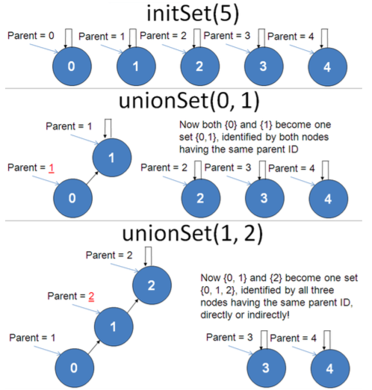

Slide 5
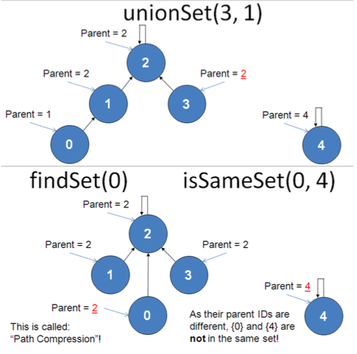

Slide 6
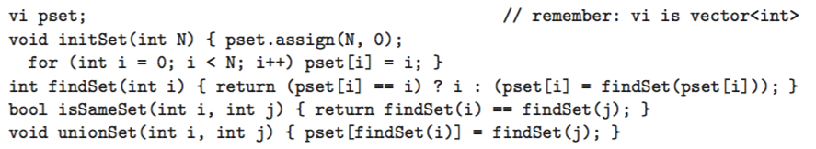
Implementation
Notes:
assign N ints with value 0

Slide 7
Exercises
UVA 739 – Network Connections
UVA 297 – Quadtrees

